Slide 1
Lecture 34
Near Field Communication (NFC)

Slide 2
Introduction to NFC
Near Field Communication is a short-range high-frequency, wireless communication technology.
It extends the Radio Frequency Identification (RFID) standard by combining the interface of a smartcard and a reader into a single device.
The standard enables NFC to be used in three specific ways:-
Card emulation :- The device is a contactless card (and thus can be read by other readers).
Reader mode :- The device can read RFID tags.
P2P mode :- Two devices can communicate to exchange data.

Slide 3
Introduction to NFC
In Android 2.3, Google introduced the Reader Mode NFC functionality.
In Android 2.3.3, the ability to write data to an NFC tag and exchange data via P2P mode is also available.
NFC tags consist of data encoded in NFC Data Exchange Format (NDEF).
Each NDEF message consists of one or more NDEF records.
To use NFC functionality in your application, you need to declare the following permission in your manifest:-
<uses-permission android:name="android.permission.NFC" />
To restrict the installation of the application to devices that can use NFC, add the following to your manifest as well:-
<uses-feature android:name="android.hardware.nfc" />

Slide 4
Reading a Tag
Reader mode is for receiving notices when an RFID/NFC tag is scanned.
In Android 2.3, the only means to do this is to create an Activity that listens for the android.nfc.action.TAG_DISCOVERED intent, which is broadcast when a tag is read.
In Android 2.3.3 and later, when an NFC tag is discovered the tag object is placed into an Intent as an EXTRA_TAG.
The system then begins to follow a logic flow to determine the best Activity to which to send the intent.

Slide 5
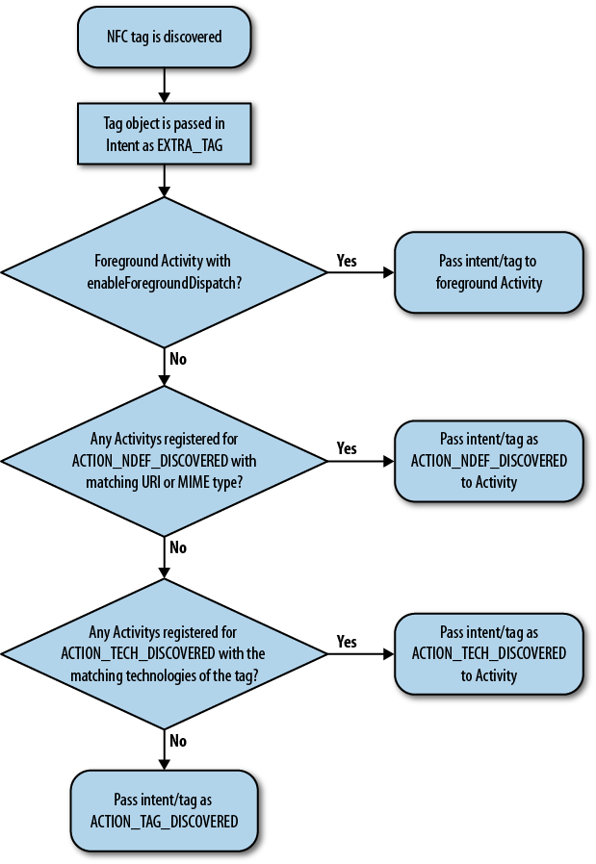
NFC tag flow in Android

Slide 6
Writing a Tag
To write a tag, the Tag object must be used to get the appropriate TagTechnology within the tag.
NFC tags are based on a number of independently developed technologies and offer a wide range of capabilities.
The TagTechnology implementations provide access to these different technologies and capabilities.
Get the tag from the Intent:-
Tag mytag = (Tag) intent.getParcelableExtra(NfcAdapter.EXTRA_TAG);
Get the Ndef (TagTechnology) from the tag:-
Ndef ndefobj = Ndef.get(mytag);
Note the following requirements when performing I/O operations with a Tag Technology:-
connect() must be called before using any other I/O operation.
I/O operations should never be called on the main application thread.
Only one TagTechnology can be connected at a time. Other calls to connect() will return an IOException.
close() must be called after completing I/O operations with a TagTechnology.

Slide 7
P2P Mode
P2P mode is enabled in Android 2.3.3, when one device is set up to transmit data over NFC to another device that can receive NFC data.
The sending device may also receive data from the receiving device, and thus peer-to-peer (P2P) communication occurs.
To do this, the enableForegroundNdefPush() method is used.
This enables the Activity to transmit an NdefMessage, when it is in the foreground, to another NFC device.
The enableForegroundNdefPush() method must be called from the main thread (such as in onResume()).
Syntax:-
public void onResume() {
NdefRecord[] rec = new NdefRecord[1];
rec[0] = newTextRecord("NFC Foreground Push Message");
NdefMessage msg = new NdefMessage(rec);
NfcAdapter.getDefaultAdapter(this).enableForegroundNdefPush(this, msg);
}

